Slide 1
QPSK Tutorial Project
Building a QPSK transceiver using MATLAB HDL Coder and commodity, open-source hardware
Richard Cagley, Ph.D. Toyon Research Corp. (805) 869-1092 rcagley@toyon.com

Slide 2
Project Goals
There are three keys things that are currently lacking in order to accelerate radio development (and addressing these deficiencies)
Software tools (MATLAB HDL Coder for HLS)
Prototyping platform (COTS FPGA board and Toyon FMC-based RF front-end)
System integration support (example hardware drivers, tutorials, debugging methodologies)
This demonstration/tutorial project is meant to:
Provide additional “glue” software and examples that take MATLAB code to a complete FPGA-based wireless transceiver
Allow these radio implementations to be tested and evaluated on an FPGA Mezzanine Card (FMC) based RF transceiver

Slide 3
Outline
Benefits of MATLAB HDL Coder for wireless transceiver design work
Toyon’s FMC-based, low-cost Chilipepper RF front-end
Low-cost, ZED (Zynq Evaluation & Development) board
QPSK tutorial project
Overview
Code entry for Tx/Rx components and simulation
Hardware deployment and experimentation
FPGA based microprocessor interfacing
Summary

Slide 4
Benefits of MATLAB HDL Coder for Wireless Transceiver Development
MATLAB is an excellent HLS language for implementation of advanced signal processing algorithms in FPGAs
MATLAB is the de-facto standard for initial implementation of advanced signal processing algorithms
Unparalleled testbench capabilities mean that very complex stimulus can be generated and processed
The same floating point code and testbench can be used for fixed-point conversion and RTL generation
When algorithm designers have more control of the destiny of their ideas, FPGA designs can be created more efficiently and more of them can get done
MATLAB addresses challenging language entry issues including complex algorithms that involve:
Conditional logic
Mixed logic/BRAM access
For loops and vector/matrix operations

Slide 5
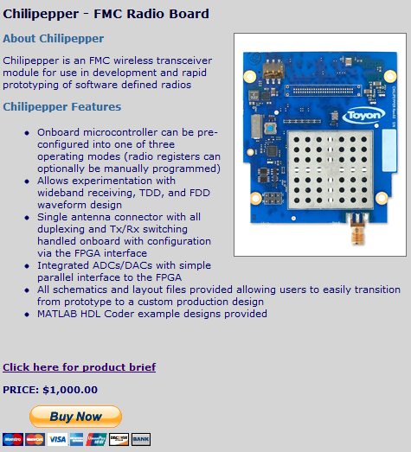
Chilipepper – Toyon’s FMC-Based, Open, Low-Cost Transceiver
Several vendors have developed/marketed FPGA Mezzanine Card (FMC) VITA 57 boards for SDR development
Toyon’s is particularly well suited to real-world prototyping that can lead to a practical radio design
Is available at http://www.toyon.com/chilipepper.asp

Slide 6
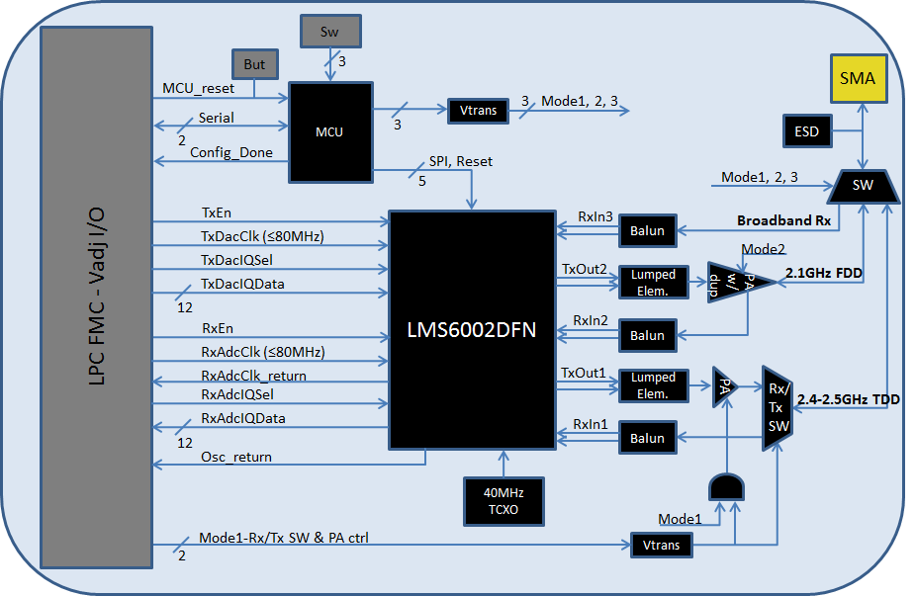
Chilipepper – Toyon’s FMC-Based, Open, Low-Cost Transceiver (cont.)
Based on the Lime Microsystems LMS6002 RF-IC transceiver
Onboard AVR MCU masks complexity during prototyping (instant on capability) while enabling user to customize
Full FDD/TDD transceiver functionality for experimentation with real-world waveforms, such as 3GPP

Slide 7
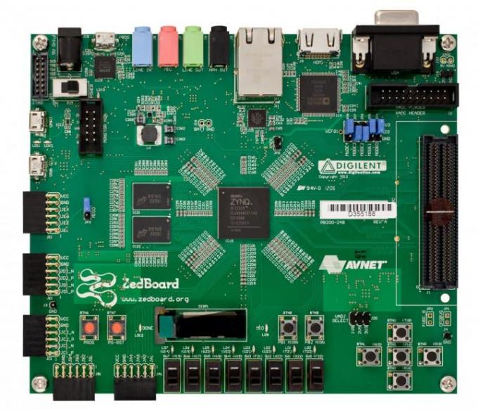
Low-Cost ZED Board
Keeping with the theme of low-cost, easily accessibly, and open platforms, this tutorial project will use the Digilent/Avnet ZED board
One onboard LPC FMC connector will host Toyon’s radio board
External peripherals can be used to provide for some neat uses of the transport stream, e.g., h.264 transmission

Slide 8
QPSK Tutorial Project Overview
The goal is to provide the user with three MATLAB based elements:
MATLAB HDL Coder Tx core
MATLAB HDL Coder Rx core
Complete MATLAB simulation that pairs the Tx/Rx cores with a channel model
FPGA processor
MATLB HDL Coder Tx core
Channel and noise model
MCU interface/ modulation
SRRC filtering
Noise
MATLB HDL Coder Rx core
Multi-path
Demod and MCU interface
Time offset correction
Frequency offset correction
SRRC filtering

Slide 9
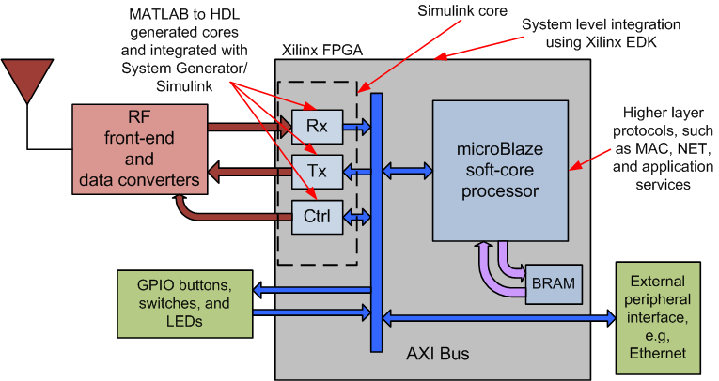
What does a complete radio look like?
Along with MATLAB HDL Coder cores we also seek to provide an example for how to create a complete, working transceiver using Xilinx EDK and supporting tools

Slide 10
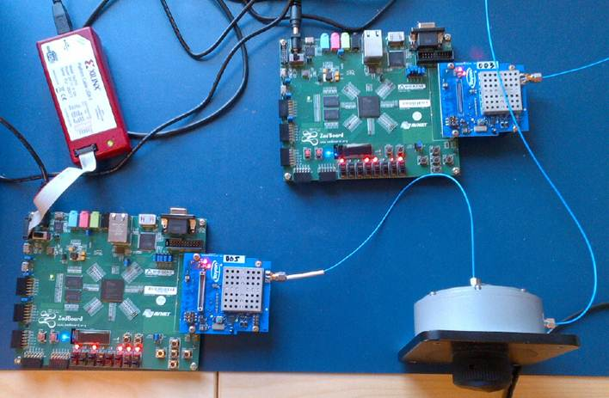
Initial Experimental Setup

Slide 11
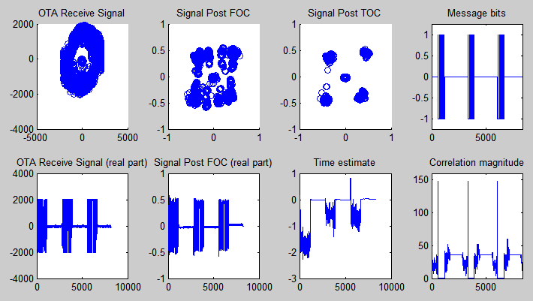
Data captured with Chipscope/ Soft-touch over the air
Packet transmission is pretty good at this point
Chilipepper seems stable
Chilipepper AGC works
In the process of creating a basic MAC layer and serial port demonstration application

Slide 12
Set of tutorial labs
Seeking to walk through how to create this reference design with the user on their own using MATLAB to HDL workflow. The labs will include:
Output a tone
Receive a tone
Output a QPSK pattern
Achieve carrier lock on a QPSK pattern
Determine timing offset on a QPSK pattern
Receive and decode a transmitted pattern
Interface a processor with transmitter in order to output a message
Receive packet

Slide 13
Summary
Current development tools and techniques are inadequate for developing future waveforms
The increasing sophistication of algorithms results in mounting difficulty in translating from high-level models to hardware
As chip vendors provide larger FPGAs and mixed hardware/software system-on-a-chip (SOC) it becomes an insurmountable task for a new waveform to be implemented through “hand-coding” HDL
Work in this tutorial seeks to provide new and experienced users with an example of a complete, working wireless transceiver
Extensible to the inclusion of future algorithms
Low cost with nothing “hidden” to the user

